Slide 1
Introduction to Game Development with Pygame
A talk by Lily Williams

Slide 2
What will I learn from this talk?
How to install and set up Pygame
Some Pygame basics, like printing to the screen and getting user input
Where to find and learn to use more Pygame features
Simple game development techniques, including the game loop pattern
After this talk, you’ll be ready to start writing your own game!

Slide 3
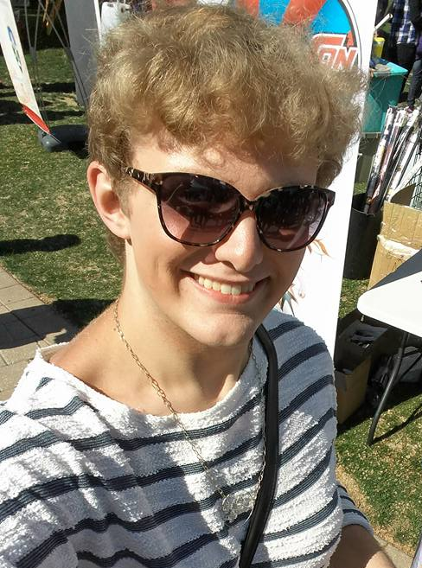
Who am I?
Lily Williams
Junior at Vanderbilt University
Major in Chemical Engineering
Started as a self-taught coder
VandyHacks board member
Watches too much anime

Slide 4
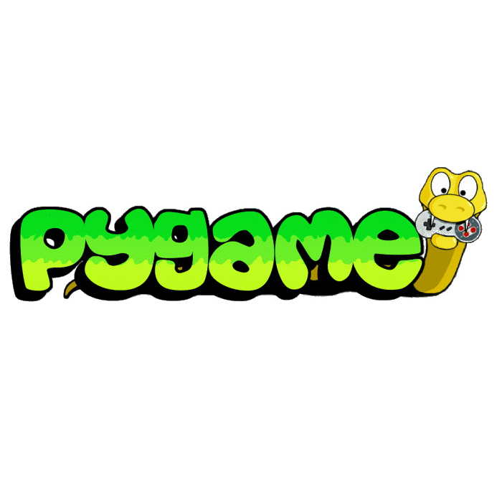
Getting started with Pygame
http://www.pygame.org/wiki/

Slide 5
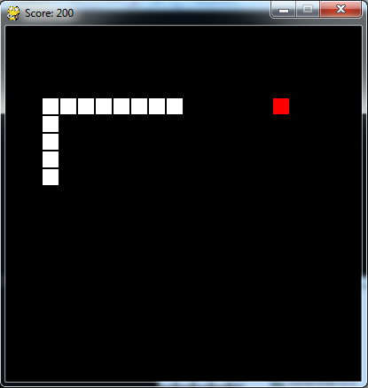
Making a game - Snake

Slide 6
Key components of the game
Screen
Snake
Keep track of where it’s been, how long it is, if it has any collisions, etc.
User input
Everything else
Frame updating
Placing and keeping track of the pellet
Scoring

Slide 7
The game loop
The quintessential pattern of game development
A loop that repeats for the duration of the game
Each iteration is a frame
Key components of the loop:
Updating the screen
Underlying game logic
Receiving user input
The order of these components subtly affects the game

Slide 8
How to build upon this game
Use object-oriented design
Allow the user to restart the game without closing
Remember high scores
Add options and pause menus
Multiplayer mode

Slide 9
Where to go from here
You’ve seen how to build a rudimentary game, and have had a taste of Pygame
From here, you’re ready to:
Learn more Pygame features through the wiki or online tutorials
Practice Pygame and game development by modifying Snake
Move forward and begin developing your own game!

